Slide 1
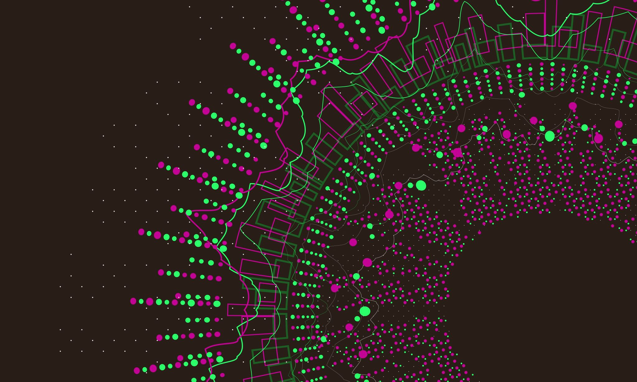
Analyzing Alzheimer’s Gene Expression
By Safa Akhter Noya
BIO 2110: Programming for Biologists

Slide 2
Purpose of the Project
Goal: Identify early gene expression differences between Alzheimer’s (PDA) and control (CDA) samples.
Why this matters: Alzheimer’s disease affects immune and vascular pathways. Gene expression profiling helps reveal how these pathways become disrupted.
Genes analyzed:
IL17C — immune‑related cytokine
TEK — vascular stability
CCL4 — inflammatory chemokine

Slide 3
Tools & Dataset
Dataset:
Norm_NR.txt microarray dataset
Tools Used:
Google Colab
Python
pandas
matplotlib
Main Steps:
Load + clean dataset
Extract genes of interest
Calculate Control_mean, Alz_mean, FoldChange
Generate tables + bar chart

Slide 4
Table 1: Mean Expression Values
All three genes show higher expression in Alzheimer’s samples.
CCL4 has the highest expression across both probes.
TEK shows moderate expression.
IL17C shows lower expression but still increases.
 | GeneSymbol | Control_mean | Alz_mean
7758 | IL17C | 6.695537 | 6.873259
19102 | CCL4 | 13.094788 | 13.626846
22894 | CCL4 | 13.570006 | 14.077097
28609 | TEK | 5.387521 | 5.689869

Slide 5
Table 2: Fold Change Values
Positive fold change = higher expression in AD.
CCL4 shows the strongest upregulation → strong inflammatory signal.
TEK shows moderate increase → vascular involvement.
IL17C shows a smaller but consistent rise.
 | GeneSymbol | FoldChange
7758 | IL17C | 0.177721
19102 | CCL4 | 0.532058
22894 | CCL4 | 0.507091
28609 | TEK | 0.302348

Slide 6
Table 3: Summary Table
All three genes are upregulated in AD.
Two CCL4 probes show nearly identical results → increases confidence.
TEK and IL17C also show meaningful increases.
 | GeneSymbol | Control_mean | Alz_mean | FoldChange
7758 | IL17C | 6.695537 | 6.873259 | 0.177721
19102 | CCL4 | 13.094788 | 13.626846 | 0.532058
22894 | CCL4 | 13.570006 | 14.077097 | 0.507091
28609 | TEK | 5.387521 | 5.689869 | 0.302348

Slide 7
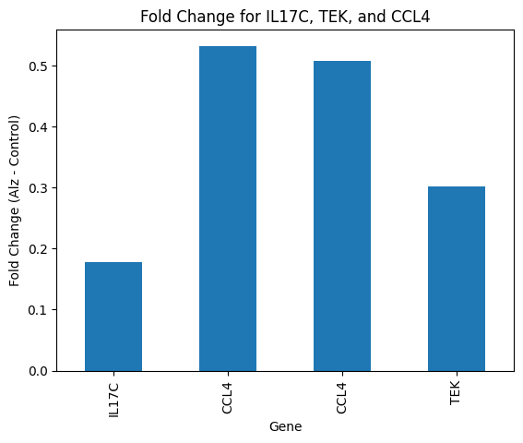
Figure 1: Bar Chart of Fold Change
CCL4 has the largest fold change.
TEK is moderately upregulated.
IL17C shows a smaller increase.
This pattern supports known AD mechanisms: inflammation + vascular disruption.

Slide 8

Biological interpretation
CCL4 upregulation → heightened inflammatory signaling in AD.
TEK increase → potential blood‑brain barrier and vascular instability.
IL17C increase → immune involvement, though less pronounced.
Consistent upregulation across two CCL4 probes increases confidence.
Results align with current AD research showing immune and vascular dysregulation.

Slide 9

Summary of findings
IL17C, TEK, and CCL4 are all upregulated in Alzheimer’s samples.
CCL4 shows the strongest increase → major inflammatory role.
TEK suggests vascular dysfunction.
Findings highlight potential biomarkers for further study.

Slide 10
References
Abed, S., et al. (2025). Immune‑Related Gene Biomarkers… Molecular Neurobiology.
Alzheimer’s Association. (2024). Biological mechanisms of Alzheimer’s disease.
Heneka, M. T., et al. (2015). Innate immunity in Alzheimer’s disease. Nature Immunology.
Python Software Foundation. (2024). Python 3 documentation.
McKinney, W. (2022). pandas documentation.
Matplotlib Development Team. (2024). Matplotlib documentation.
https://ftp.ebi.ac.uk/biostudies/fire/E-MTAB-/094/E-MTAB-6094/Files/Norm_NR.txt

